Slide 1

Manchester Raspberry Jam 33
October 2015

Slide 2
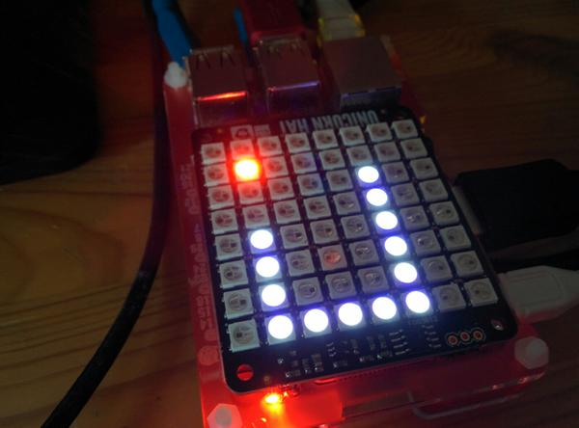
Last Time:

Slide 3
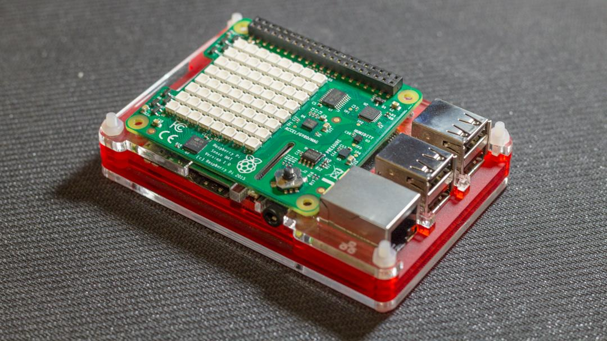
Today:

Slide 4
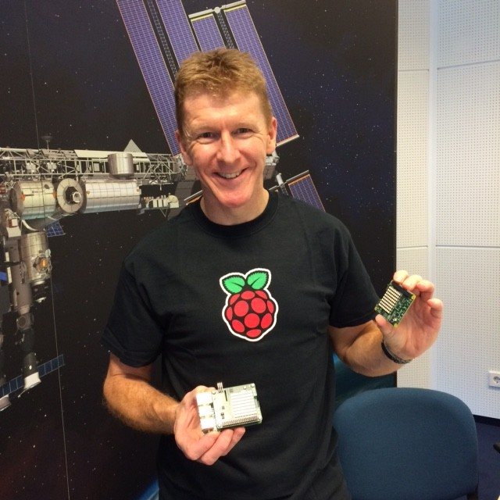
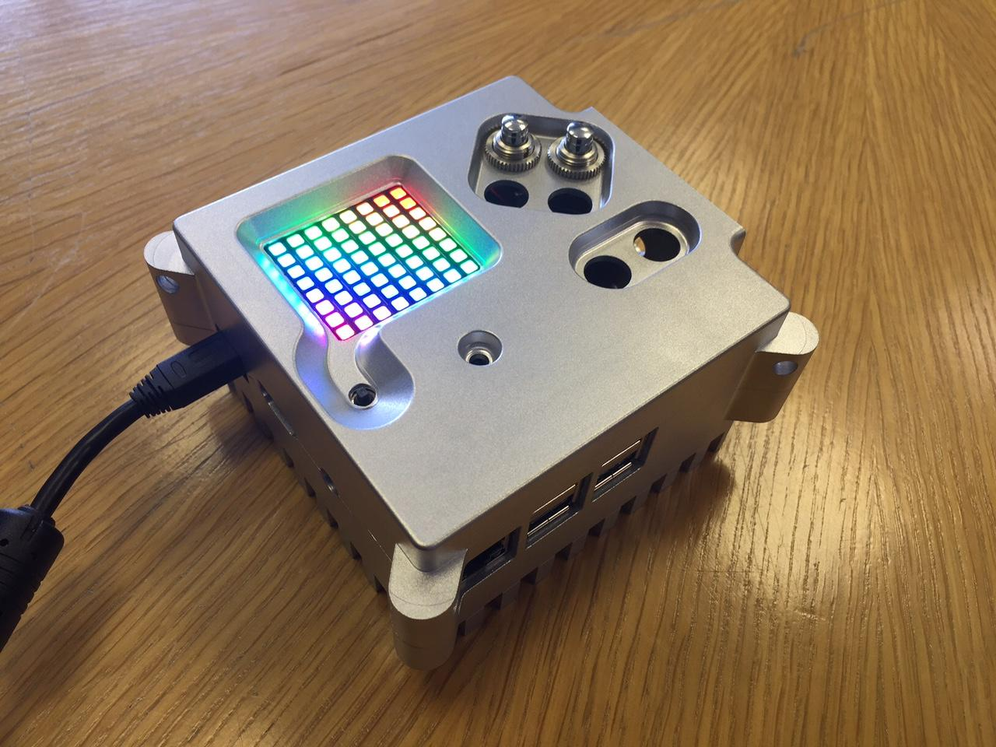
Today:

Slide 5
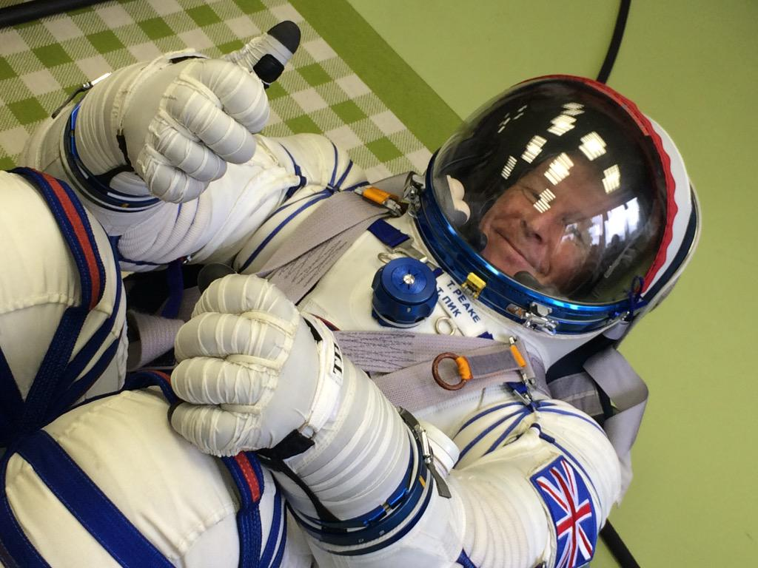
Today:

Slide 6
Workshops
Morning:
Introductory workshop
Manchester Raspberry Jam weather station
Accelerometer & G-Force
Afternoon: Various mini-projects
Outputting telemetry
Accelerometer display
Motion controlled Snake
Spirit level

Slide 7
Today:
11:15 - Morning workshop
14:00 - Lunch
14:15 - Afternoon workshop
WiFi:
SSID MMU-Visitor
Pass. University
Next Jam:
Saturday 12th December
mcrraspjam34.eventbrite.co.uk
Slides and other downloads at: bit.ly/McrRaspJam

